Slide 1



AI Testing
Presented by: Jerry Gao, Professor, and Director
San Jose State University – Excellence Research Center on
Smart Technology, Computing, and Complex Systems
Date: 6/4/2018

Slide 2
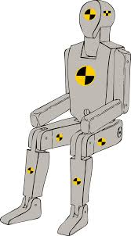
What Is AI-Based Software Testing?
Definition:
“It refers to the leverage and applications of AI methods and solutions to automatically optimize a software testing process in test strategy selection, test generation, test selection and execution, bug detection and analysis, and quality prediction.”
AI-based test
planning
Leveraging AI-based
intelligent techniques
In a software test process
AI-based test case
generation
AI-Based Software Testing
Apply software quality
assurance standards
and evaluation metrics
AI-based test data
generation
AI-based
test execution
AI-based bug
validation & analysis

Slide 3
Why Is AI-Based Software Testing Important?
Major objectives include:
Test selection and test set optimization using data-driven AI techniques
Test data selection and recommendation using data-driven AI solutions
Automatic test execution using AI techniques
AI-based test result validation
Bug detection, analysis, and prediction based on large-scale testing history data
Adequate quality and complexity prediction using data driven AI approaches
Increase efficiency and
productivity for a test process
Optimize a test process
using AI techniques
Apply optimized
test strategies
AI-Based Software Testing
Reduce software
testing costs by reduce
human operations
Assure the quality
under-test software
with consistent quality assessment criteria
Enable software
Quality analysis & prediction
Increase bug detection
effectiveness and speed

Slide 4
Testing AI Software/Systems
Definition:
“Testing AI software refers to diverse testing activities for AI-based software/systems. Well-defined quality validation models, methods, techniques, and tools must be developed and applied for AI-based software to facilitate the test activities to achieve well-defined test requirements and meet pre-selected adequate testing criteria and quality assurance standards.”
Major Focuses:
Testing AI functional features to assure their adequate quality in accuracy, consistency, relevancy, timeliness, correctness, and so on using data-driven and AI approaches
Testing AI software’s quality of system service parameters based on well-defined quality standards and assessment criteria. These include: system performance, reliability, scalability, availability, robustness, and security, and so on.
(c) Apply data-driven AI techniques to facilitate AI testing processes and test automation

Slide 5
What to Test in AI Software?
– The Scope of AI Software Testing
Expert system
Identification & classification
Intelligent learning capability
Human/animal/objects
Business intelligence and decision
Recognition & profiling
Recommendation & selection
AI Software Testing
Human/animal/objects
Intelligent commands & actions
Behavior detection/analysis
Analytics and prediction capability
Human/animal/objects
Question & answer capability
Context identification & classification
Unmanned vehicles
Control validation and healthcare check

Slide 6
Testing Requirements Analysis for AI Software
Identifying AI features
For each identified feature, identify its AI testing requirements
Knowledge-based modeling for AI testing
Object Relation
Object Identification
Position relation
Single object
multiple objects
Position relation
Object
Object Context
Object Behavior
2D Context
Single behavior
Different behaviors
Current behaviors
3D Context
Classification
Single type of objects
Different types of objects

Slide 7










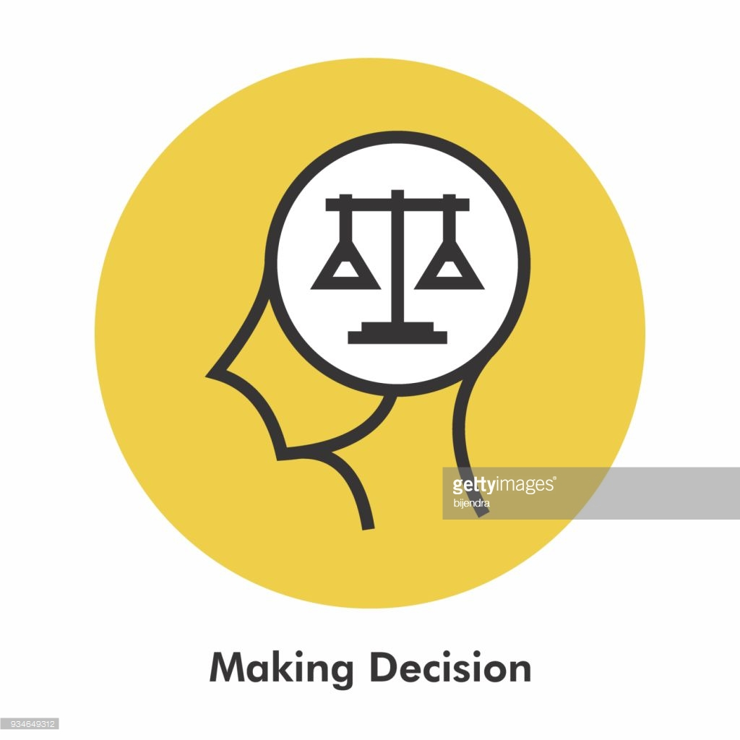
AI Software Feature Testing
Inputs
Outputs
AI Function
Features
IOT Data

Slide 8
Why Do We Need AI Testing?
Many current and future software will be built with AI-based features and functions.
Existing techniques and tools are not adequate to test AI-based features and functions
Lack of well-defined and experience approved quality validation models and assessment criteria
Lack of AI-based testing methods and solutions for AI software
Knowledge-Based AI
Software Features and
Behaviors
Uncertainty of AI Software
Features and Behaviors
AI Software
Multiple dimension-based
rich media input data with
Multi-input modals
Learning-Based AI Software
Features and Behaviors
Test data sets selected
from big data pools
Real-time context-based
diverse inputs affecting system
outputs, actions, and behaviors

Slide 9



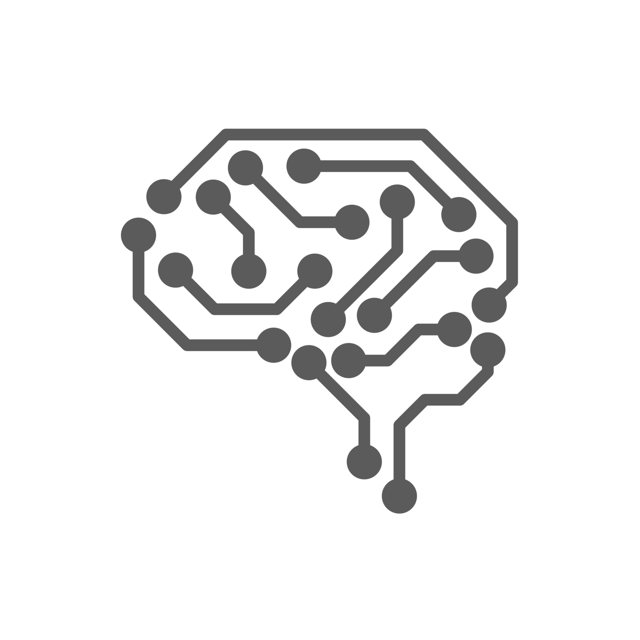





AI Software Quality Validation Approaches
Crowd-Sourced Testers
Crowdsourced Test Robots without continuous learning capabilities
Cloud-Based
AI Software
AI based Test Automation
Metamorphic
(Non-Oracle) Testing
Data Model Based Testing
Classification Testing
Learning-Based AI Testers
Rule-Based Testing

Slide 10
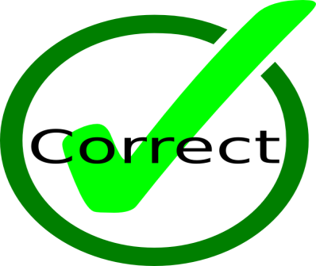









Quality Parameters for AI Software
System Reliability
Function/System Accuracy
Function/System Correctness
System Performance
Function/System Consistency
AI Software
System Robustness
Function/System Relevancy
System Scalability

Slide 11







Smart AI Software/System Quality Testing and Assurance
- Challenges, Issues, and Needs
Testing Adequacy??
Coverage?
Measurement?
Lack of AI-Based
Test Automation
Tools
Testing Modeling
& Requirement Analysis
Lack of Quality
Validation & Assurance
Standards
Lack of Certified
Training Data for
AI Software
Where are the automatic
quality tools/methods for
training data?

Slide 12

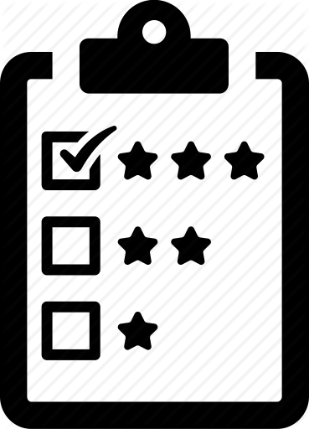

AI Software Quality Validation Process
AI function test modeling
AI test modeling
AI test modeling
AI function test planning
AI test modeling
AI function test design
AI test design
AI test design
AI test design
AI test execution
AI test execution
AI test execution
AI function test quality evaluation
AI function test execution
Test Plan
Test
Quality
metrics
Models
Test
results
Not Accepted
AI system test modeling
AI test modeling
AI test modeling
AI system test planning
AI test modeling
AI system test design
AI test design
AI test design
AI test design
AI test execution
AI test execution
AI test execution
AI system test execution
AI system test quality evaluation

